Slide 1
Switching Behavior of Izhikevich Model
Yoon JaeHong, Zhongxi Li
2017 November

Slide 2
Outline
Goal, background, motivation
Demo of the Izhikevich switching behavior
Valid parameters (a, b) via genetic algorithm
Setting
Goal function
algorithm
Analytical solution of (a, b)
Discussion
Extension to multiple neurons

Slide 3
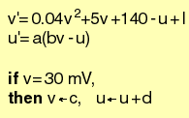
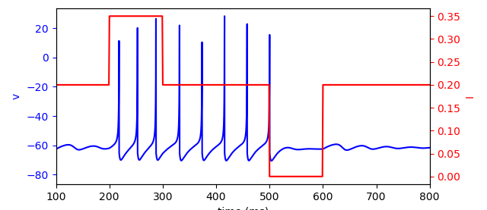
Goal
Find and explain a set of parameters such that one Izhikevich-type neuron can exhibit switching (or memory) behavior.
Izhikevich model
Switching behavior
Turn on
Turn off

Slide 4
Motivation and Challenges
Motivation:
We believe biological working memory can be carried out by a single neuron with a clean mathematical interpretation.
Challenges:
The Izhikevich model is defined in a hybrid manner. The conditions make the model discontinuous.

Slide 5
Motivation and Challenges
Genetic algorithm → parameter set (a, b)
Izhikevich model
Define switching behavior
Explanation
Nonlinear dynamics analysis

Slide 6
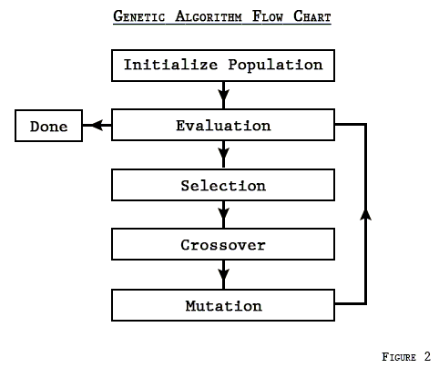
Path 1: genetic algorithm
Basic idea: select the best parameters from a pool of candidates. The best parameters then become parents of the next candidate generation.

Slide 7
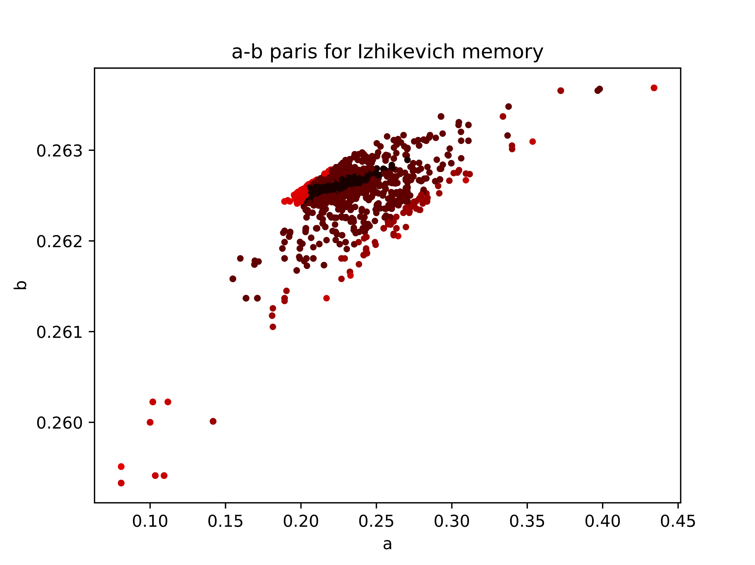
Path 1: genetic algorithm

Slide 8
Path 2: Bifurcation analysis
2
1
3
4
5
1
2
3
4
5
saddle point
saddle point
saddle point
saddle point
saddle point
stable spirals
unstable spirals
stable spirals
stable spirals
stable spirals
Observation: the switching behavior is associated to a Hopf-bifurcation
But where is the limit cycle?
Notes:
For certain pair of (a,b) parameters
Match the notations
Need a sigma-delta portrait

Slide 9
Path 2: Bifurcation analysis
For fixed (a, b), it is the stimulus current that drives the bifurcation.
I = 0.35
Hopf-bifurcation
I = 0.15
Notes:
Sigma-delta trajectory. Fixed a and b, sweep I

Slide 10
Path 2: Bifurcation analysis
Find more parameters that enables Hopf-bifurcation
current I
I = 0.2
I = 0.4
(a, b) curve

Slide 11
Two interesting observations:
Majority of optimization results lie within the theoretical prediction (I < 0.2)
There are some outliers, which somehow locate in I > 0.2 (see red lines)
Even with I < 0.2, some theoretical predictions does not produce switching effect. For instance
I = 0
I < 0.2
I > 0.2
I = 0.4
Genetic algorithm findings with I switching between 0.2 and 0.35
a = 0.4448, b = 0.2584, I(potentiation) = 0.2
Why?

Slide 12
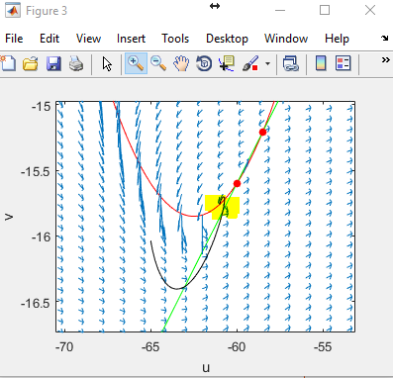
Even with I < 0.2, some theoretical predictions does not produce switching effect. For instance
/* latest update */
For I = 0.4, a = 0.4448, b = 0.2584, there are something weird: both fixed points are shown to be unstable; however, the state variable somehow stays somewhere else. And this quiescent location is not even a fixed point!
a = 0.4448, b = 0.2584, I_{potentiation/stim.} = 0.2/0.4
This is not because of the weak stimulation/potentiation current
a = 0.4448, b = 0.2584, I_{potentiation/stim.} = 0.4/1.0
Implies that the hopf-bifurcation already happened at I = 0.35

